Slide 1
Powering Digital Transformation
Platform Acceleration Labs
E&Y, Bangalore
27th July, 2019

Slide 2

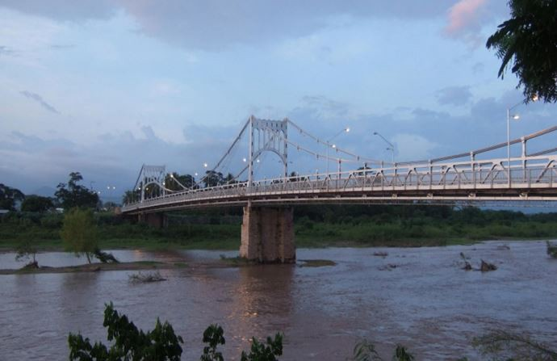

Nothing lasts for ever​
Bridge Before Hurricane
Bridge After Hurricane
Source https://medium.com/road-less-ventured/why-an-honduran-bridge-is-a-perfect-metaphor-for-disruption-2a2d7c910535

Slide 3
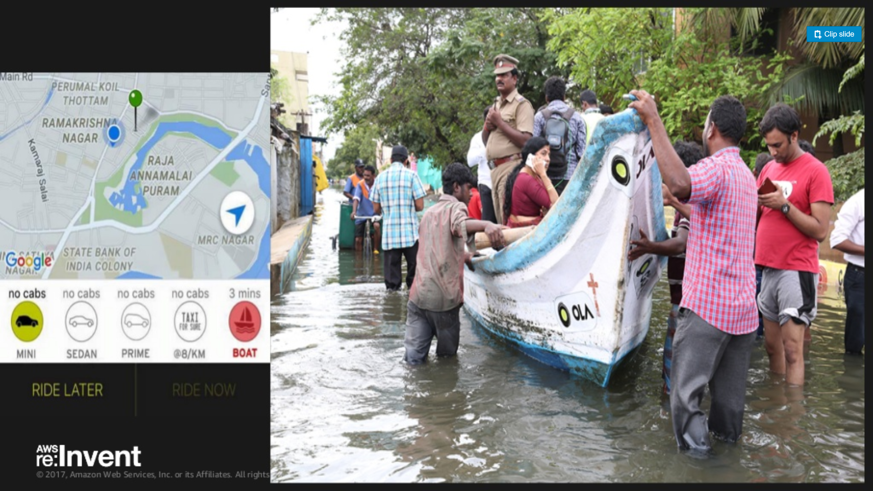

Agility in Action !
Agility in Action !

Slide 4


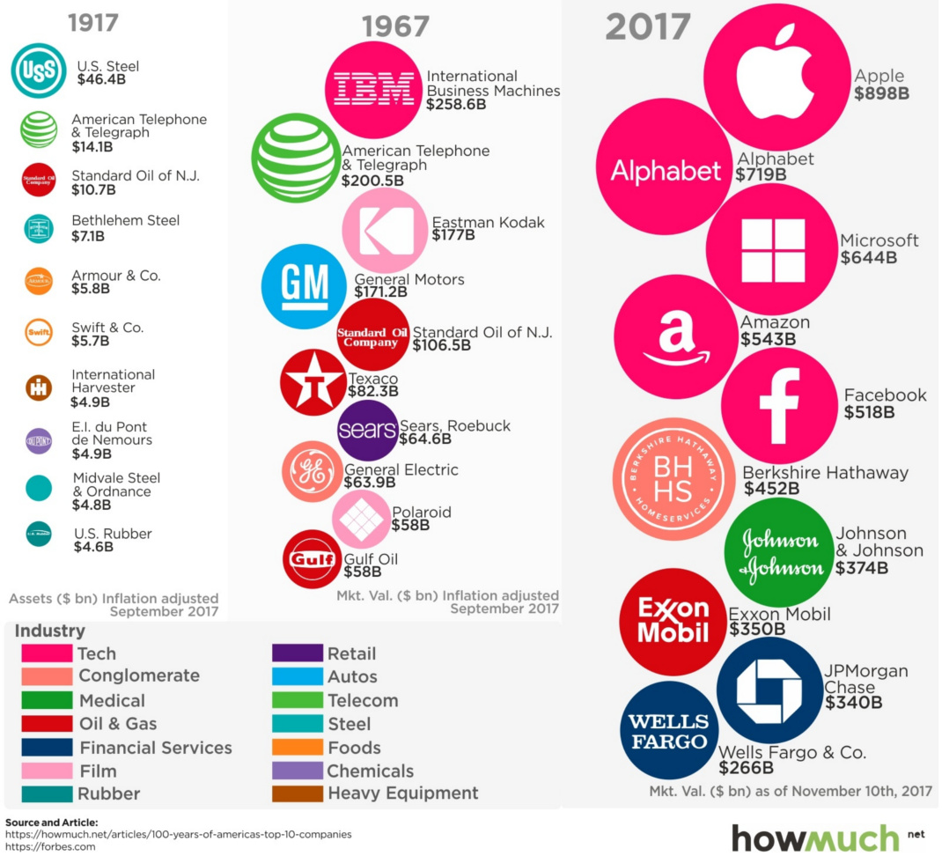
13% of Fortune 500 companies exist since 1955

Slide 5

What percentage of enterprise applications that are in use today will still be in use at least for next 5 years?
75%
85%
90%

Slide 6
DevOps
Continuous Delivery
Microservices
Not my problem
Separate tools, varied incentives, opaque process
Release once every 6 months
More Bugs in production
Tightly coupled components
Slow deployment cycles
Release early and often
Higher Quality of Code
Loosely coupled components
Automated deployments
Shared responsibility
Common incentives, tools, process and culture

Slide 7
Software Developers Spend too Much Time NOT Writing Software
Design and Coding
Brainstorming
Administrative tasks
Managing Environments
Waiting for Test/Build
Average Hours/Week
17.5 hrs ~ 40% of full work week!
7
Sources: “Electric Cloud LinkedIn Survey to software developers”

Slide 8

Introduction to
Pivotal Cloud Foundry

Slide 9
Cloud Native Application Platforms
Business Value, Agility & Cost Savings
Traditional IT
IaaS
Cloud Native
You Manage
Applications
You Manage
Applications
Applications
Data
Data
Data
You Manage
Runtime
Runtime
Runtime
Middleware
Middleware
Middleware
Pivotal CF
+
Choice of IaaS
O/S
O/S
O/S
Virtualization
Virtualization
Virtualization
Servers
Servers
IaaS
Servers
Storage
Storage
Storage
Networking
Networking
Networking

Slide 10


















Helping You Modernize Efficiently at Scale
DEVELOPMENT
OPERATIONS
CI/CD Tools,
ID, Security
AUTOMATION
To Lower Your Ops Cost and Increase Your Velocity
App Deployment
& Management
4. CLOUD
NATIVE
Health, Metrics,
Patching
FREEDOM
To Run Your App on Any Cloud
Compiled, staged, containerized, deployed and managed by platform, or BYO Cloud Ready Docker Image
Availability
3. CLOUD
RESILIENT
VISIBILITY
End to End Logging, Monitoring and Auditability
Services
Marketplace
Native
User Provided
Partner
Visibility &
Administration
Apps & Platform
Dashboards
GOVERNANCE
Common Set of Developer-Self-Serviced Frameworks
2. CLOUD
FRIENDLY
Operating
System
Container Orchestration
RESILIENCY
Auto-Scale, Blue/green Deployments and Health Mgmt.
1. CLOUD
READY
Cloud API
SPEED
Move Cycle Time from Months to Weeks to Days or Hours
Azure
GCP
10

Slide 11
Four Levels High Availability – Built In!
PCF
PCF
PCF
Zone 1
Zone 2
A
B
C
A
B
C
A
B
C
A
B
C
A
B
C
A
B
C
A
B
C
VM1
VM2
VM3
B
B
B
B
Runtime VM
3. Resurrector restarts failed VMs
Process
B
A
B
C
A
B
C
A
B
C
A
B
C
OS,
Mware
OS,
Mware
OS,
Mware
B
B
B
B
If an app fails, PCF reboots app in a new container.
If a process fails, PCF restarts the process
If an OS or network failure occurs PCF kills the VM and reboots the host in a new Virtual machine.
If a datacenter rack fails, PCF ensures applications stay running in multiple availability zones
App Fail
Process Fail
VM Fail
Rack Fail

Slide 12

How many members in this group are actively migrating/ modernizing legacy applications?

Slide 13
How many people are building microservices net new?​

Slide 14
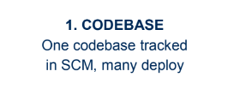
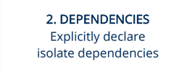
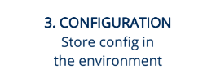
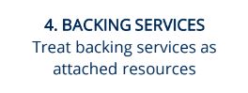
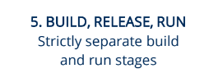
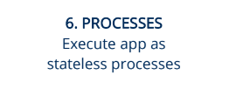
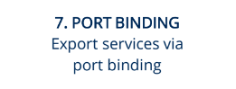
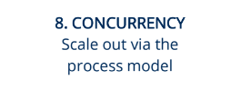
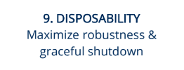
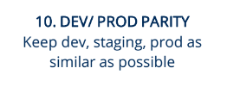

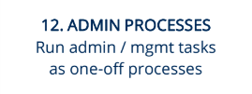
Compliance to 12/15 Factor
12
FACTOR

Slide 16
What are Microservices?
If every service has to be updated in concert, it’s not loosely coupled!
Loosely coupled service oriented architecture with bounded contexts
If you have to know about surrounding services you don’t have a bounded context.

Slide 17
Microservices are NOT
Monolithic Application
Service
Service
HTML
JavaScript
MVC
Enterprise Service Bus
Service
Service
OR
Data Access
Service
Service
Tightly Coupled
Centralized

Slide 18







Microservice Architecture
Business Change
HTTP
HTTP
HTTP
HTTP
HTTP
HTTP
AMQP
AMQP
…
Relational
DB
Key/Value
Store
Graph
DB
18

Slide 19
Challenges of Distributed Systems
Configuration Management
Service Registration & Discovery
Routing & Load Balancing
Fault Tolerance (Circuit Breakers)
Monitoring and Tracing
Concurrent API Aggregation & Transformation

